Slide 1
Facial and Object
Recognition
Final Year Project 2018-2019
Final Assessment
Ankita Gonnade BT15CSE028
Shruti Nashine BT15CSE055
Under the guidance of
Dr. Praveen Kumar

Slide 2
Contents
Problem Statement
Facial recognition
Object recognition
Results
References

Slide 3
Problem Statement
Visually challenged people have strong sense of touch, hearing, smell and taste.
The inability to recognize known individuals and surrounding objects in the absence of audio or haptic cues severely limits the visually impaired in their daily routines and puts them at risk of privacy and physical security.
In this project, the blind will be himself able to identify people and object due to face recognition and object detection.

Slide 4
Face recognition
We implemented our facial recognition system using Python,OpenCV and deep learning for images and real time videos streaming
Dataset Creation
Encodings
Algorithm used
Challenges faced

Slide 5
Dataset Creation
Before we train the model, we need to gather and create dataset of many and different faces. We used two ways for creating the dataset namely:
Custom face recognition dataset
We need to gather faces of people we want to recognize and also those faces needs to be quantified in some manner. This is also called facial recognition enrollment.
The other method is that the physical access to a person is necessary. To create more diverse dataset we can gather images of the same person under different light conditions, moods, times of day and emotional states.

Slide 6
Online face recognition dataset
This involves building a deep learning image dataset.
In order to build the image dataset, we utilized Microsoft’s Bing Image Search API, a part of Microsoft’s Cognitive Services. From logging in, we used its key to get the api into use. The program enable us to download images via command line as it is easy and there is no need to open browser or use browser extensions to download the images from the search.
It programmatically downloads large number of images via a simple query.

Slide 7
Encodings
Every face has some facial features like the distinguishable landmarks, the different valleys and peaks. These features of faces are also called nodal points. Each human face consists of approximately 80 nodal points. Some of them are:
● Width of the nose
● Shape of cheekbones
● Distance between the eyes
● Length of jaw line
These point features of faces are measured by creating a numerical code known as faceprint which represents face in the database in the form of 128-d embeddings. So face recognition is a problem of extracting features by training a deep neural network where distance between the feature vector of same face will be minimized and for different face it will be maximized. Here the same face have similar features and others faces will have different features.

Slide 8
Steps of the algorithm used
Decides if the features captured are of the new sample or it is of the existing sample.
Localization of a face in live video stream.
Computes the 128d embeddings for faces
Face Preprocessing
Feature Matching
FACE
IDENTIFIED
Face Detection
Feature Extraction
Training
Normalize the coarse face detection
Train the network with the feature extracted in previous step
Dataset of enrolled users
Real time Stream

Slide 9
Object Recognition
We implemented our object recognition system using Python,OpenCV and pre-trained dataset with single shot detector
Dataset
Algorithm used
Challenges

Slide 10
Dataset
There are two type of deep neural networks usually involved in recognition - base network (mobilenet) and detection network (single shot detector).
High level features for classification or detection are provided by the base network. MobileNet uses of convolution to produce high level features.
To implement classification, detection network i.e. SSD is used directly to get the detection because SSD directly uses last convolutional layer on base network itself for detection task.
This model can therefore detect 90 objects classes in images (+1 for the background class).

Slide 11
Algorithm
We go through the following steps to classify image objects using deep learning :
1) Loading the model
We start by loading the class label rows from disk into a list, which is in our caffemodel file, specifying camera to be used to take the input stream, and the threshold that we need to make any detection. after which forward method is used to forward-propagate the frame for classification.
2) Preprocessing
Our input frame requires fixed spatial dimensions so we need to make sure the the frame captured is resized before we perform mean subtraction to normalize the input.

Slide 12
3) Output
As there are chance that multiple objects are detected in a single frame, we loop over our predictions. Associated with each detection, we apply a check on the confidence.
To decide whether or not to display the prediction in the terminal, we check if the confidence is high enough or not. If the confidence is high enough, we finalize the prediction.
Once we get the detection and draw the rectangle on the frame over the detected object and display it in the frame along with the confidence.

Slide 13
Dataset anomalies
Many factors need to be taken care of while creating a dataset. So, we have to create dataset under various conditions like the light conditions, different expressions, face orientation, along with any accessories like glasses etc.
For object recognition, the object needs to be examined under following conditions:
Lightning
Positioning
Mirroring
Occlusion

Slide 14
Hardware Solutions
GPU
For each person we need to have enough number of pictures including all the factors mentioned in dataset anomalies so that the training happens efficiently.
This implies that our training dataset will have huge amount of pictures.
Also, for real time processing of video, we need to have higher frame rate. So to accomplish all these requirements, we need to configure GPU in our system.
To enable GPU in our system, we followed the CUDA toolkit documentation.

Slide 15
Droidcam
In order to correctly train and classify the faces and objects in the frame, it is very essential that they are captured as it is.
To ensure that the resolution of the frame captured is up to the mark, we need a better camera than the default webcam.
The substitute that we chose instead of webcam is camera of our android mobile phone. To integrate this with our system, we use droidcam.
This live stream from the mobile camera is given as input to our program which gives a frame with better resolution and hence better results.

Slide 16
Challenges
If we encounter a new but very similar face, we get a false positive i.e. a match with the wrong person even if the face is unknown. Our algorithm is basically based on k nearest neighbours, so if the distance between the embeddings computed for new face and the trained embeddings is greater than k, we get a match. So, it all boils down to the computation of the 128 embeddings of the new face which in turn depends on the contours and features of the face.
When we train the images, we basically compute the facial embeddings of each face in the image and finally optimize them to be as far from a different face as possible. Doing this for such huge dataset requires a lot a time which is not very efficient.

Slide 17
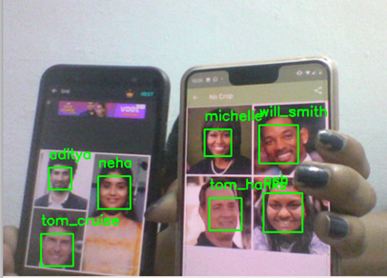
Results
Frame rate
Since our project deals with recognition in real time video stream, one of the very important aspects in evaluating the results is frame rate.
Our program runs on an average frame rate of
8 frames per second.
Accuracy
In case of face recognition, we get a 90% accuracy in detecting true positives i.e. it correctly recognizes faces of people who are enrolled in a our dataset. We are able to recognize up to 8 people in a single frame at the same time. While recognizing that the face encountered is unknown, it mostly depends on how different the face is but we get around 50% accuracy in determining true negatives.

Slide 18
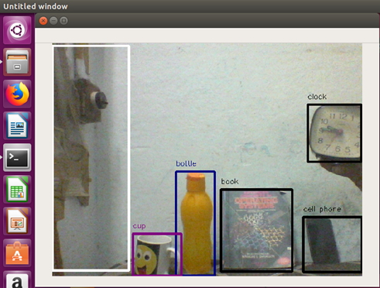
In case of object recognition, we get a 90% accuracy in recognizing objects which belong to one of the 90 object classes in our dataset. We can recognize up to 4-5 objects in the single frame at the same time.
Our accuracy increases when we use the external camera to stream the real time video.

Slide 19
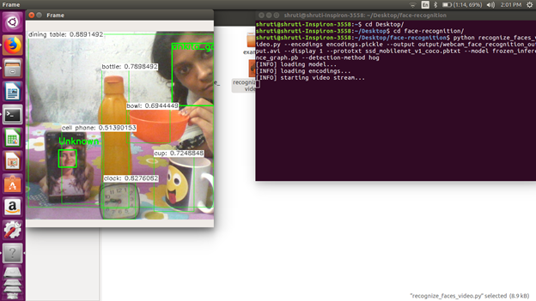

Slide 20
References
[1]https://github.com/ageitgey/face_recognition/wiki/Face-Recognition-Accuracy-Problems
[2]https://www.eeweb.com/profile/rajeevthaware/articles/real-time-face-detection-and-recognition-with-svm-and-hog-features
[3]https://azure.microsoft.com/en-in/services/cognitive-services/face/
[4]https://medium.com/@devalshah1619/face-recognition-using-eigenfaces-technique-f221d505d4f7
[5]https://www.youtube.com/watch?v=ej9wFtHZu4c
[6]https://towardsdatascience.com/faster-rcnn-object-detection-f865e5ed7fc4
[7]https://www.linkedin.com/pulse/comparison-yolo-darknet-versus-darkflow-rasmus-kromann
[8]https://docs.nvidia.com/cuda/cuda-installation-guide-linux/index.html
[9]ttp://www.skipser.com/p/2/p/android-as-webcam.html

Slide 21
Thank you

